Slide 1

Fire Detection, Prevention & Defense (FDPD) System
An IOT Approach to A State-Of-The-Art Fire Protection System
By Uchenna F. Okoye

Slide 2

Why FDPD?
Fire kills more people each year than all natural disasters combined
Many people are unaware of fire protection and safety precautions
A state-of-the-art system can save lives and hundreds of thousands in losses

Slide 3
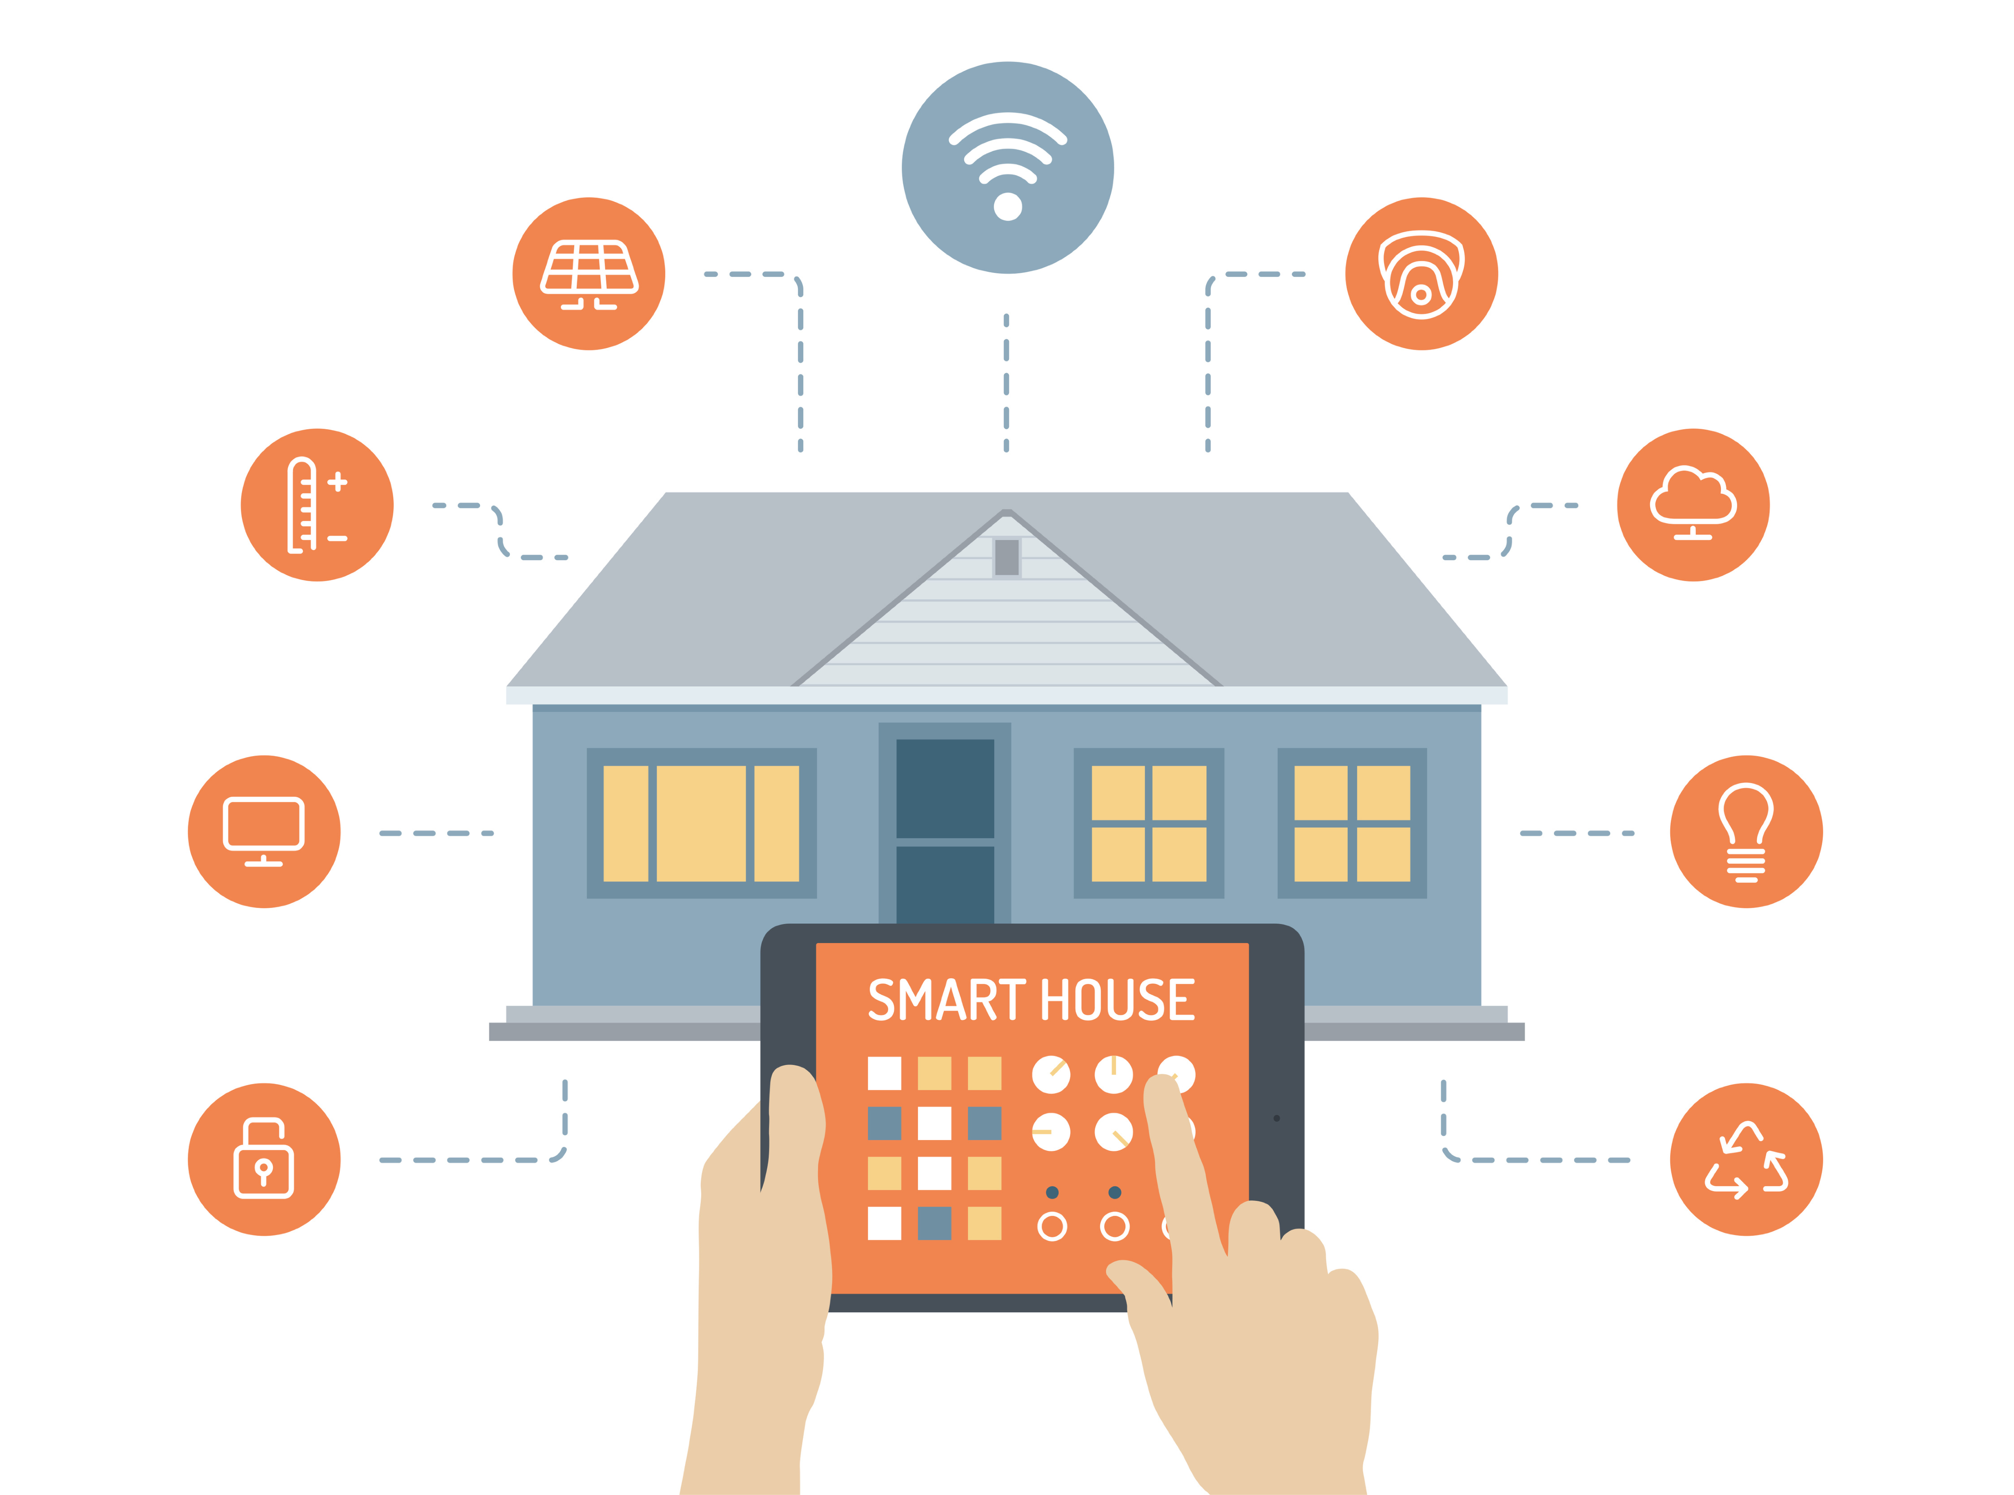
A Smart Solution
What We Offer:
Prevention
Detection
Defense
Our Tools:
A user-facing app (developed in Android and/or iOS)
Sensors & Smart Devices (i.e. smart outlets, smart sensors)
Raspberry Pi/Arduino for automation/Defense

Slide 4
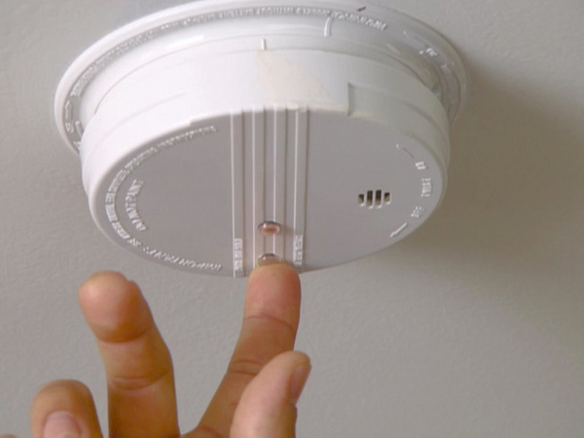
Fire Safety:
The Regular Routine
Smoke Alarm
Change batteries every year
Replace Every 10 years
One smoke alarm per floor
Test every month
Carbon MonoOxide Sensor
Replace every five to 10 years

Slide 5
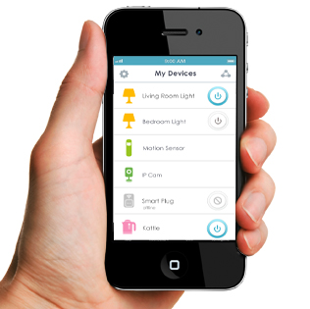
Prevention:
How IOT Can Help
Reminders:
Get reminders for monthly and yearly routines
Ability to Customize reminders
Education: In-app videos on how to test smoke and carbon monoxide sensors
Automatic Detection (non-MVP*):
Notify you when alarm batteries run low
Notify you if the alarm or carbon monoxide is no longer working

Slide 6

Detection:
How IOT Can Help
Monitor:
Monitor all outlets that have something plugged in using Android app
Monitor when heat or smoke levels rise in house
Detection & Alert:
Get notified if outlet is left plugged in for hours
Get notified when your smoke alarm goes off and in what location

Slide 7



Defense:
How IOT Can Help
Automatic Danger Control
Automatically turn off outlets power and stove power in the problem causing area
Set off the water sprinkler in home or any water outlets
Alert:
Call fire department upon fire detection
Alert all members of family through app
Education: In-app videos on what to do in a fire

Slide 8

Rewards System
Changing your alarm batteries regularly
Checking smoke detector every month
Using ion or other alarms depending on home/apartment
Watching the in-app videos on safety

Slide 9
Feasible In 10 Weeks?
Definitely! At least the minimal viable product.
Implement the basic features to provide users with prevention, detection and defense tools

Slide 10
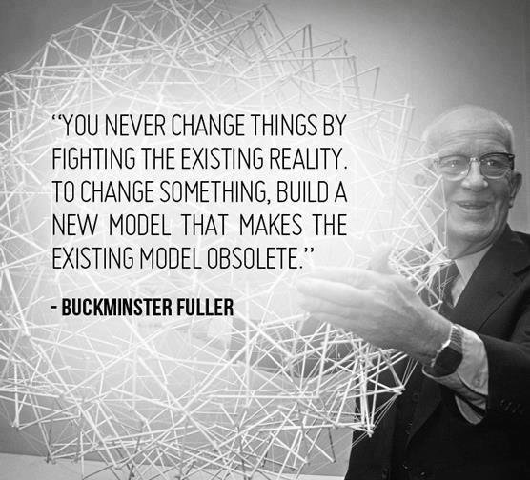

Slide 11


